Slide 1
Inference Engine using Fuzzy Logic CSC215
Guided By:
Dr. Scott Gordon
Presented By:
Jay Bibodi
Aaishwary Vadodariya

Slide 2
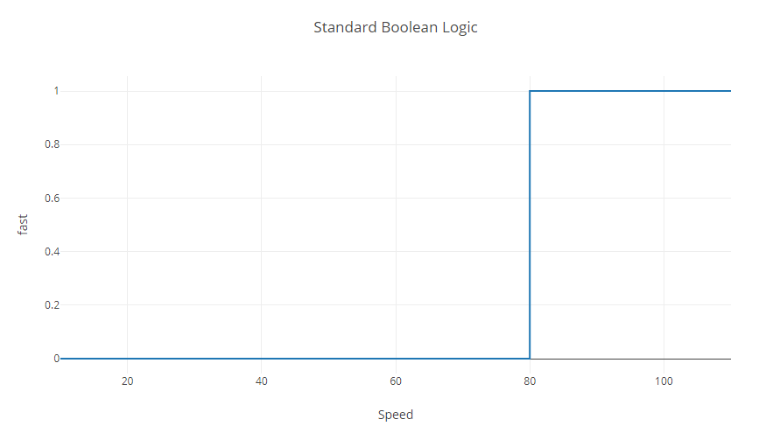
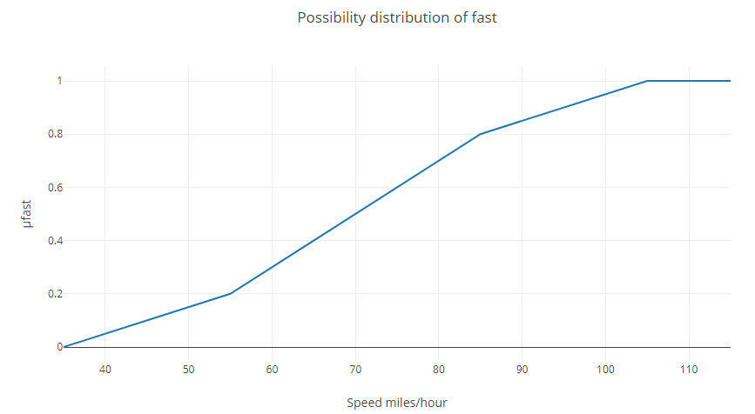
Basic Fuzzy Concepts
Boolean logic v Fuzzy logic
Crisp set v Fuzzy set
Linguistic variable
Membership function
Fuzzy rule
Fuzzy Term: fast
Speed | Grade of membership
35 | 0.0
55 | 0.2
65 | 0.4
75 | 0.6
85 | 0.8
105 | 1.0

Slide 3
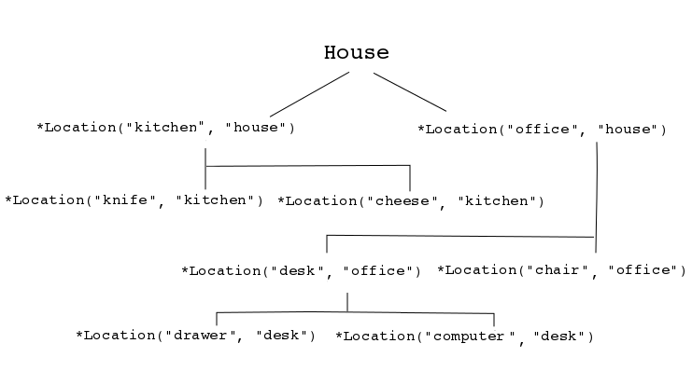

Inference Engine
Natural Language Processing
Fuzzification
Forward/ Backward chaining
Defuzzification
Applications

Slide 4

Questions

